Slide 1
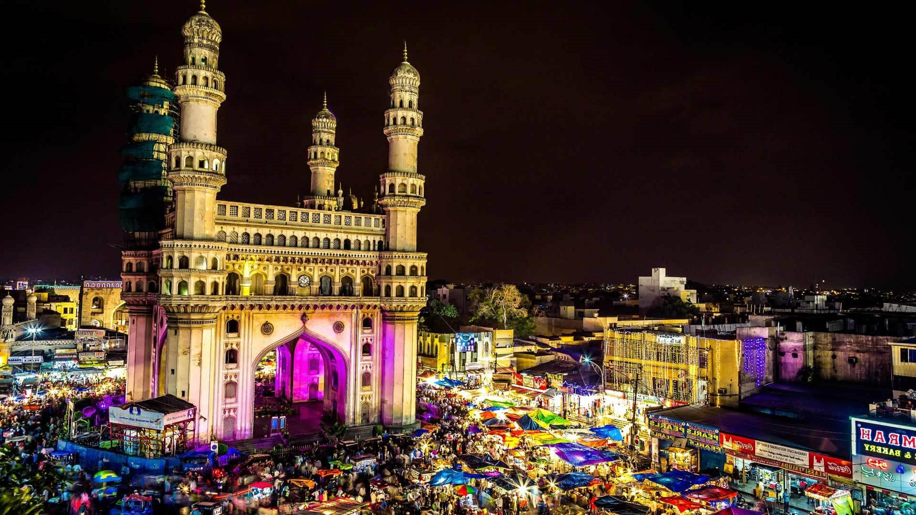
Telangana Tourism
An Insight into Telangana Tourism
Presented by:
Raktim Mazumdar

Slide 2
Overview:
Telangana is a state located in southern India.
Telangana has a rich historical heritage, with traces of ancient civilizations and dynasties. It was ruled by various dynasties, including the Satavahanas, Kakatiyas, and Qutb Shahis.
Telangana is known for its diverse cultural traditions and languages and also for its attractive landmarks such as Charminar, Golconda Fort, Ramappa Temple etc.
What?
Analyzing Telangana Tourism and Population data.
Examining the data on domestic and international visitors to understand their preferences and behaviors.
Analyzing the trends in visitor numbers and patterns across different districts and attractions in Telangana.
Why?
Identifying Growth Opportunities.
Improving Visitor Experiences.
Boosting Revenue Generation.

Slide 3
Preliminary Insights
List of top 10 districts that have the highest number of visitors.
Top and Bottom 3 districts based on compounded annual growth rate (CAGR) of visitors between 2016 and 2019.
The peak and low season months for Hyderabad based on the data from 2016 to 2019.
The top & bottom 3 districts with high domestic to foreign tourist ratio.
Secondary Insights
List of top and bottom 5 districts based on tourist to population footfall ratio in 2019.
Projected number of the domestic and foreign tourists in Hyderabad in 2025 based on the growth rate from the previous years.
Projected revenue for Hyderabad in 2025.

Slide 4
Top 10 districts having the highest number of visitors
Insights:
Hyderabad is the most visited destination in Telangana, with a significantly higher number of domestic and overall visitors compared to other districts.
All the top 10 districts with most number of visitors have substantial domestic visitors as compared to Foreign visitors, indicating their potential for tourism development.
There is a significant variation in visitor numbers among different districts, suggesting the need for targeted marketing and promotional efforts to attract more visitors to certain regions.
These highlight the potential for targeted marketing and promotional campaigns to attract more international tourists to explore the diverse attractions of Telangana.

Slide 5
Top and Bottom 3 districts based on Compounded Annual Growth Rate (CAGR) of visitors
High Growth Potential: Positive CAGR indicates a high growth potential for tourism in these areas. These districts can be targeted for tourism development and promotional activities to capitalize on their increasing visitor numbers.
Opportunities for Improvement: Negative CAGR suggests a decline or slower growth in visitor numbers. These districts may require attention and strategies to identify and address challenges that hinder tourism growth, such as infrastructure, marketing, or visitor experiences.
Regional Disparities: The varying CAGR across districts highlights regional disparities in tourism growth. This information can help prioritize resources and efforts towards districts with lower growth rates, ensuring a more balanced and inclusive development of tourism across Telangana.
Factors Affecting Growth: Analyzing the factors contributing to the high CAGR can provide insights into successful tourism strategies. Identifying and replicating these factors in other districts can help stimulate tourism growth and replicate positive outcomes.
Seasonal Variations: Analyzing CAGR reveals seasonal variations, optimizing resource allocation, marketing, and infrastructure planning for peak season visitor demands.

Slide 6
The Top & Bottom 3 Districts with High Domestic to Foreign Tourist Ratio
Diverse visitor profile: Adilabad district has a significantly higher domestic to foreign visitors ratio, indicating a higher proportion of domestic tourists compared to foreign tourists. This suggests that Adilabad attracts more domestic visitors, possibly due to its unique cultural, historical, or natural attractions that resonate with local tourists.
Potential for international appeal: On the other hand, districts like Jayashankar Bhoopalpally and Nagarkurnool have lower domestic to foreign visitors ratios, suggesting a relatively higher presence of foreign tourists. This indicates the potential for these districts to attract and cater to international visitors with experiences, services, and facilities that align with their preferences.
Focus on tourism promotion: Enhance marketing to attract domestic tourists in Mahbubnagar, Warangal (Urban), and Hyderabad with low domestic to foreign visitor ratios.

Slide 7
The Peak And Low Season Months for Hyderabad (2016-2019)
Domestic:
Seasonal peaks: June and December have high domestic visitor numbers, guiding resource allocation and marketing efforts. Potential reasons are Bonalu & Ramzan in June and Christmas & New Year’s Eve in December.
Off-peak periods: February and September have lower domestic visitors, presenting opportunities for targeted promotions to boost tourism. Possible reasons are post holiday period(Feb) and end of summer vacations(Sep).
Foreign:
Seasonal peaks: December, January and February have the most foreign visitors. Probable reasons are cooler and more comfortable temperatures and festive season(Christmas & New Year’s Eve).
Off-peak periods: April and May have lower foreign visitors. Likely reasons are hot weather and academic commitments.

Slide 8
Top and Bottom 5 Districts Based on Tourist to Population Footfall Ratio in 2019
Tourism potential: The districts with higher ratio indicates its high tourism potential. It may be beneficial to focus on developing and promoting tourist attractions in this district to further capitalize on its popularity.
Untapped potential: The districts with lower ratio indicates opportunity to explore and promote tourism initiatives in these areas to attract more visitors and diversify tourism offerings across Telangana.
Infrastructure and marketing: The districts with higher tourist-to-population ratios could benefit from investments in infrastructure development, hospitality facilities, and targeted marketing campaigns to enhance their attractiveness to tourists. This can help boost visitor numbers and overall tourism revenue.

Slide 9
Projected Number of Domestic & Foreign Tourists in Hyderabad in 2025
Domestic:
While there was steady growth from 2016 to 2017, there was a significant decline in 2018 and further decreases in subsequent years. Covid-19 can be one of the reason for this decline.
The decreasing trend in domestic visitors indicates the importance of a comprehensive recovery and revitalization plan for tourism. This may include implementing targeted marketing campaigns, enhancing safety measures, improving infrastructure, and offering unique experiences to attract domestic tourists and regain visitor confidence.
Foreign:
The projected trend indicates a consistent increase in domestic visitors despite of Covid-19. This suggests a positive growth trajectory for tourism in the region, indicating potential opportunities for the development of the tourism sector.
This also indicates the need to capitalize on this trend by implementing appropriate strategies and infrastructure development.

Slide 10
Projected Revenue for Hyderabad in 2025
Revenue Contribution: The projected revenue from domestic visitors is significantly higher than that from foreign visitors. This indicates the importance of domestic tourism as the primary revenue source for the tourism industry in Telangana. It highlights the need to focus on strategies that attract and cater to the domestic market to maximize revenue generation.
Potential for Growth: The projected revenue figures demonstrate the potential for growth in the tourism sector in Telangana. With a substantial revenue forecast from domestic visitors, there is an opportunity to further tap into the domestic market and implement initiatives that encourage higher spending and longer stays.

Slide 11
Conclusion
Hyderabad dominates as top destination, attracting more visitors.
Top districts show potential for domestic tourism development.
Varied visitor numbers call for targeted marketing efforts.
Positive growth potential in districts with high CAGR.
Strategies needed for districts with negative CAGR.
Address regional disparities for inclusive development.
Analyze successful factors for replication.
Optimize resources for seasonal variations.
Customize offerings for diverse visitor profiles.
Focus on domestic tourism for revenue generation.

